Slide 1
Some Supervisor Use Cases in Genesys Cloud:
Performance reports
Schedule and export report
Dashboards
People management
Edit user / ACD skills
Roles & Permissions
Person Details
Queues
Access all Queues & Queue details
Disconnect an interaction
Forward mobile number (Data Table)
Add Schedules
Add people
Add phone

Slide 2
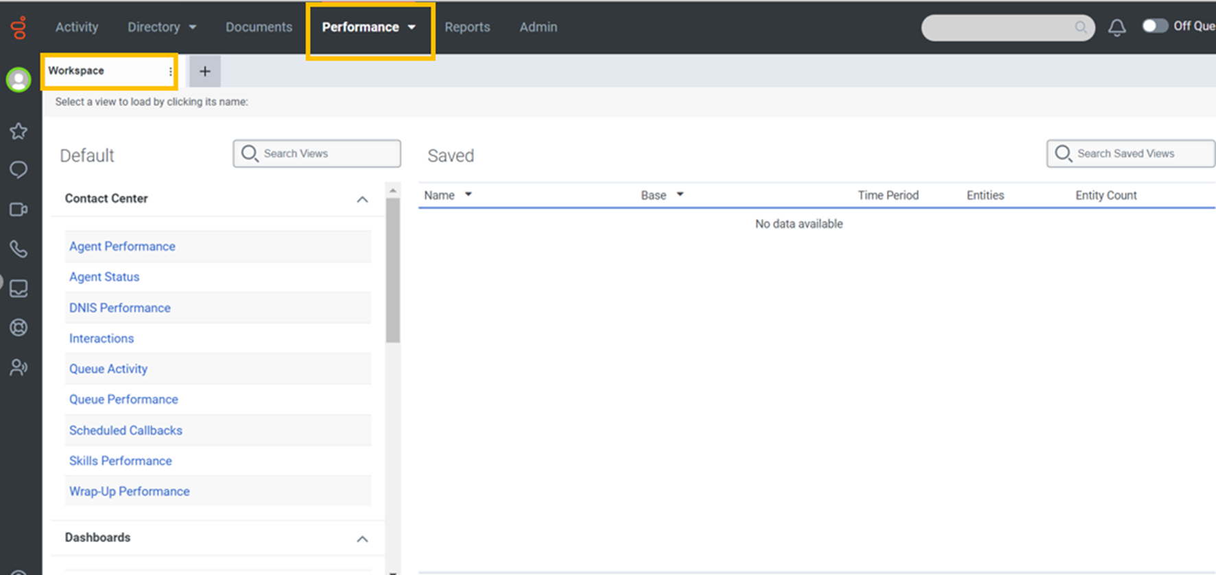
Performance reports:

Slide 3
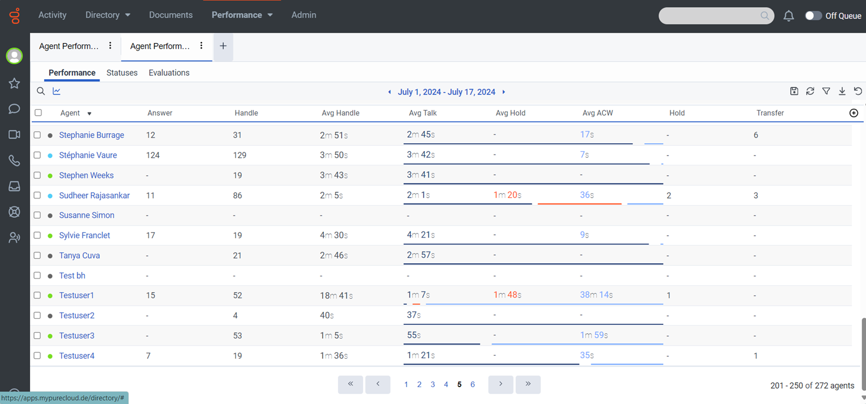
Individual Agent Performance

Slide 4
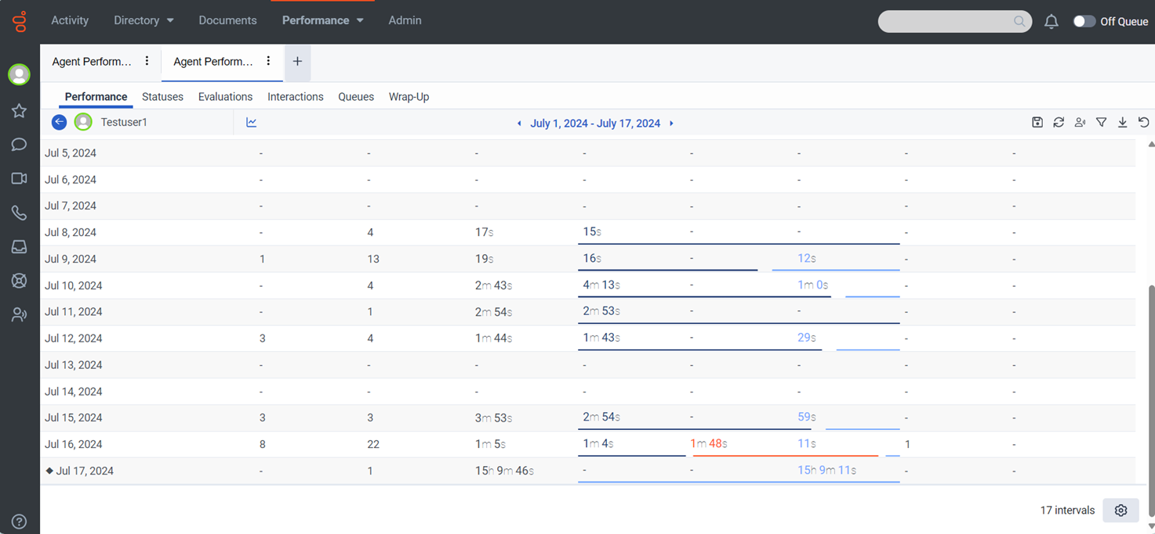

Slide 5
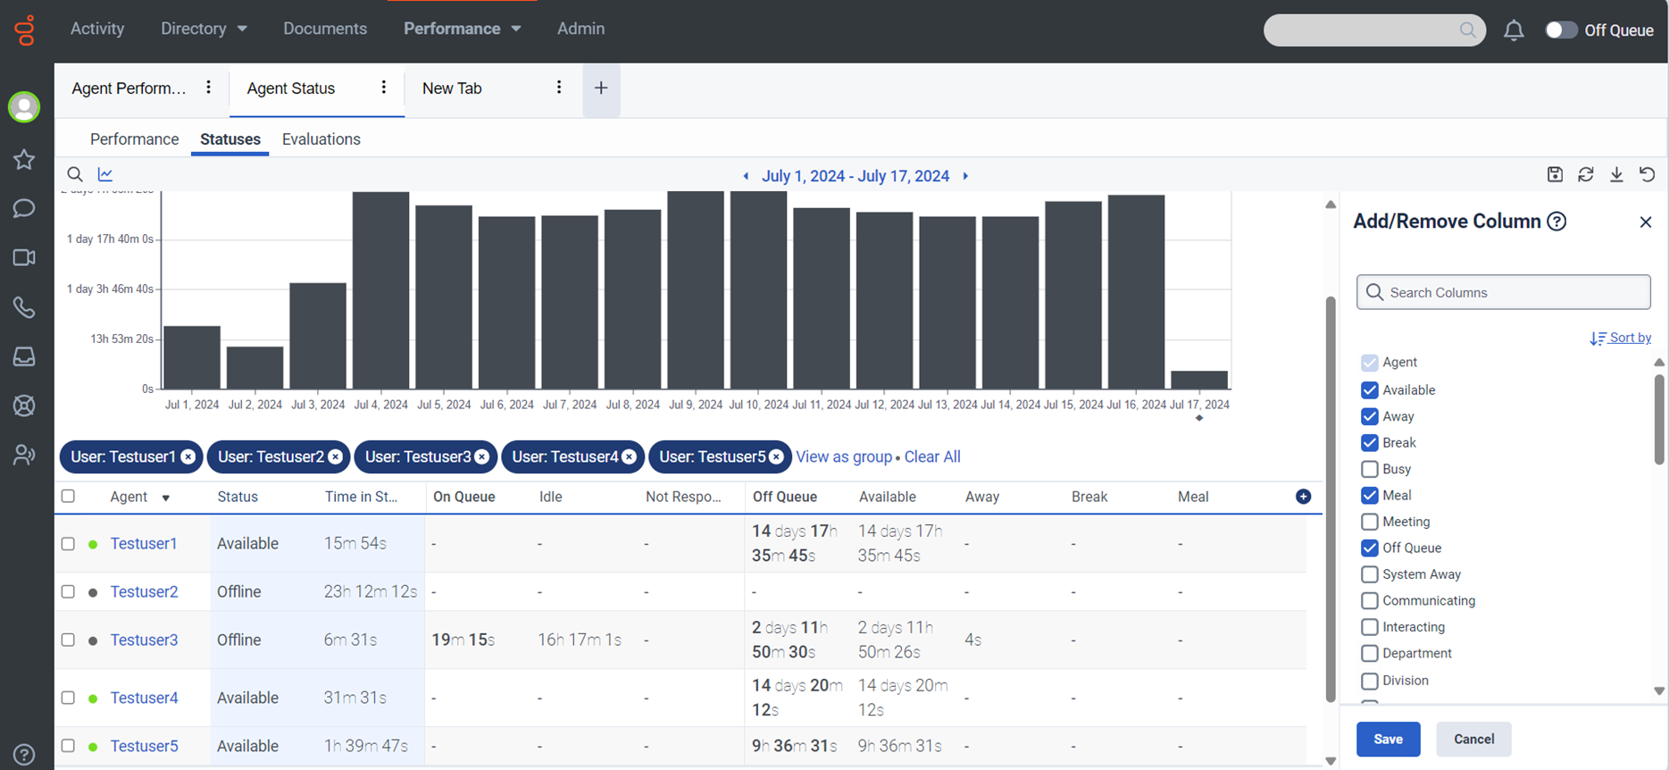
Agent Status

Slide 6
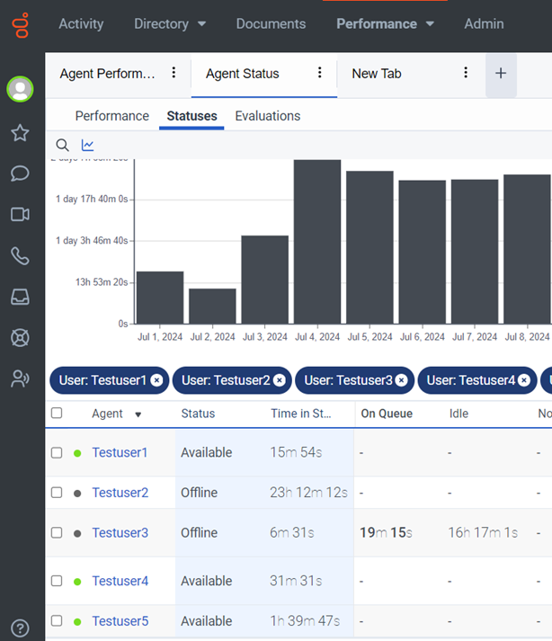
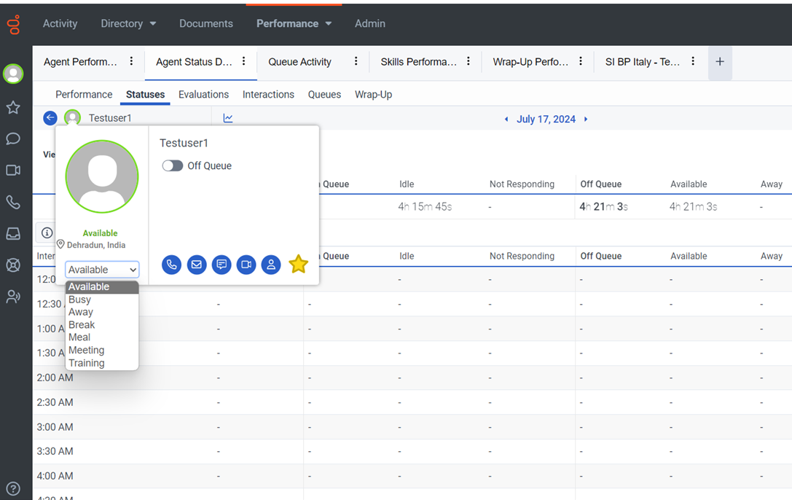
View / Modify Agent status

Slide 7
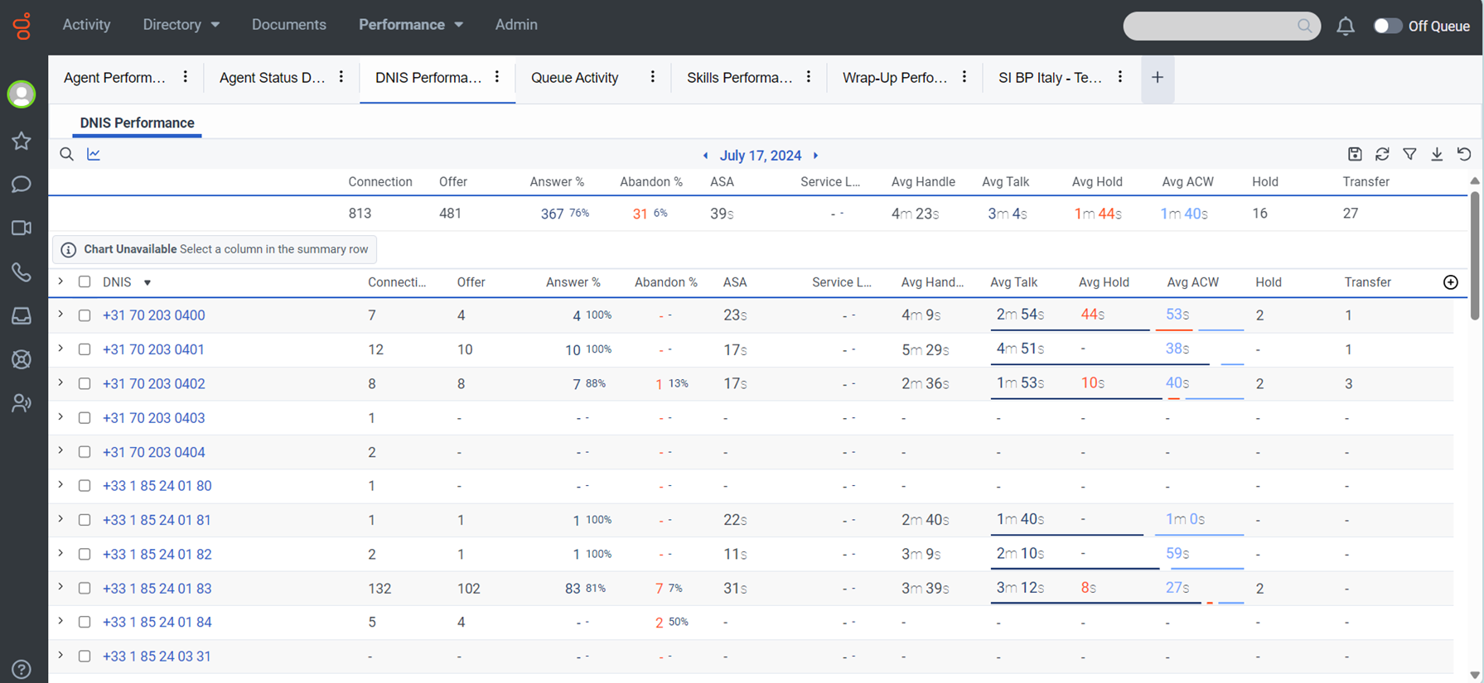
Number performance report

Slide 8
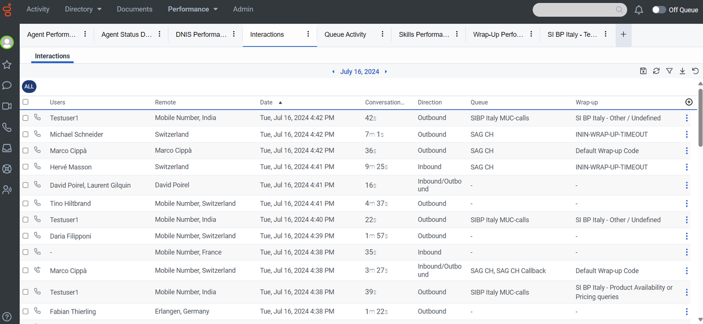
View Interactions

Slide 9
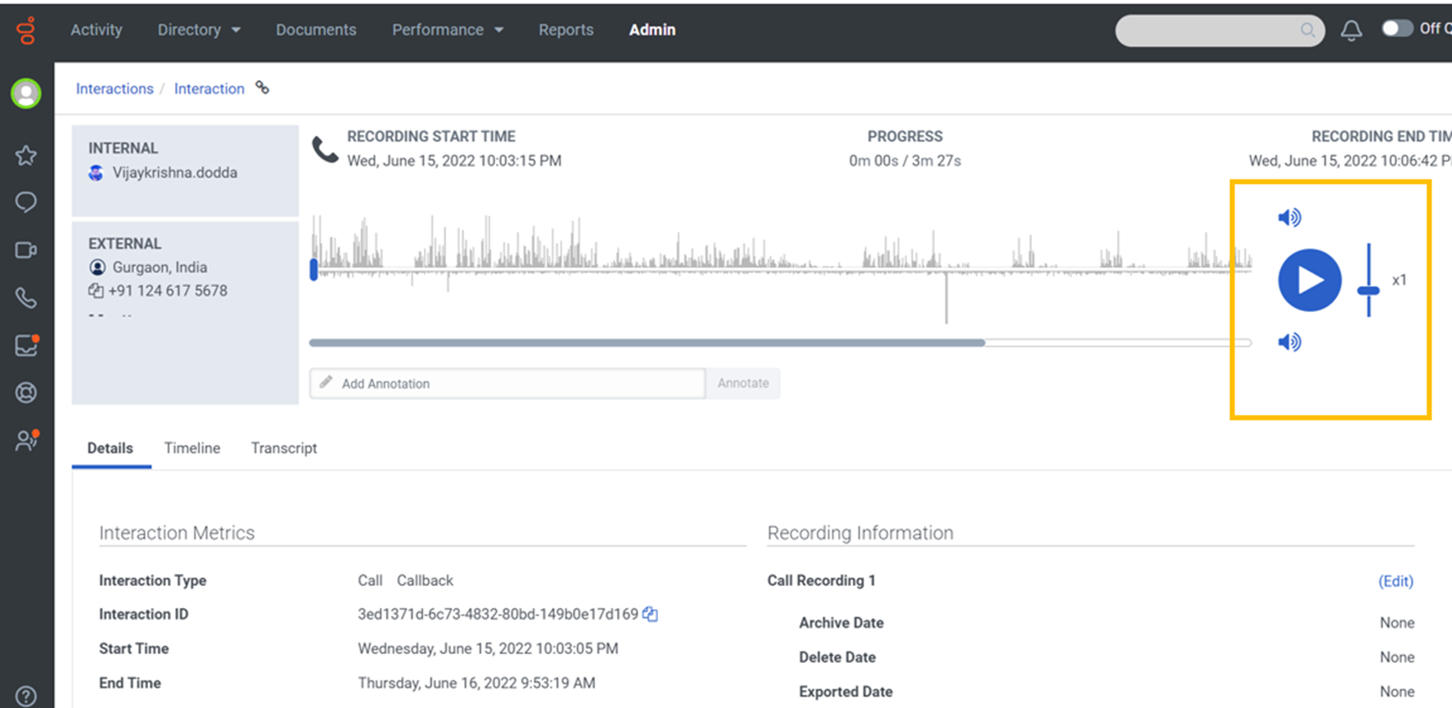
Interaction details

Slide 10
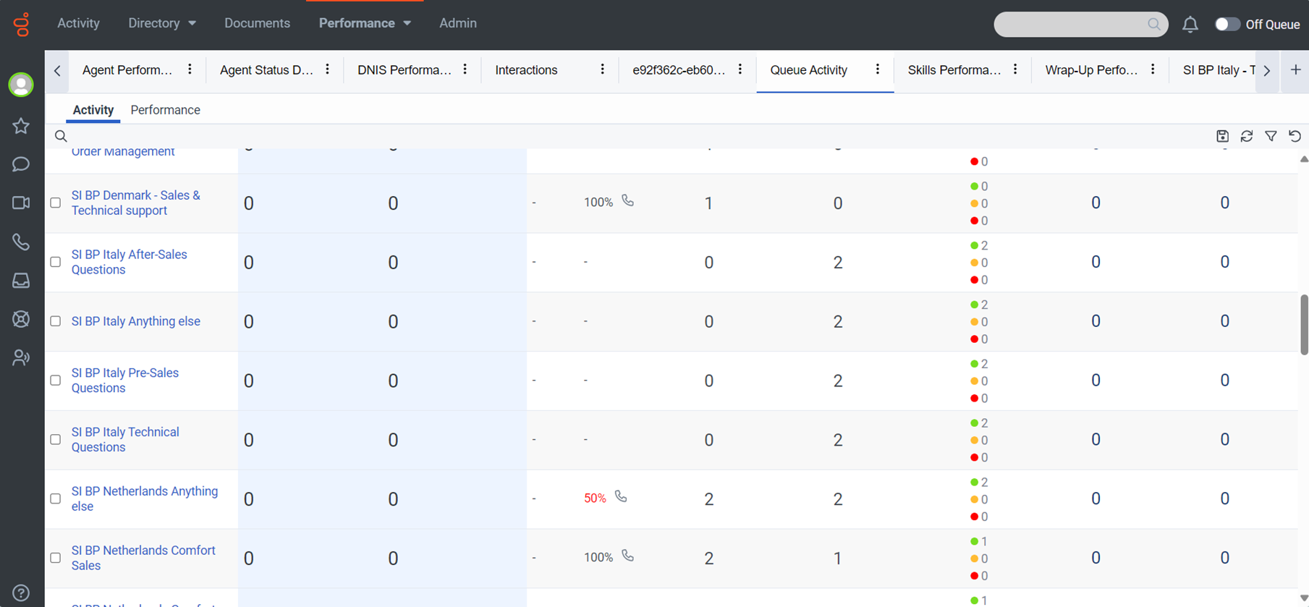
Queue activity report

Slide 11
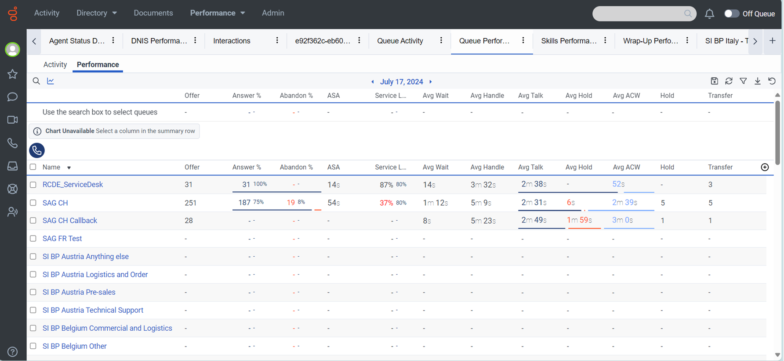
View Queue Performance

Slide 12
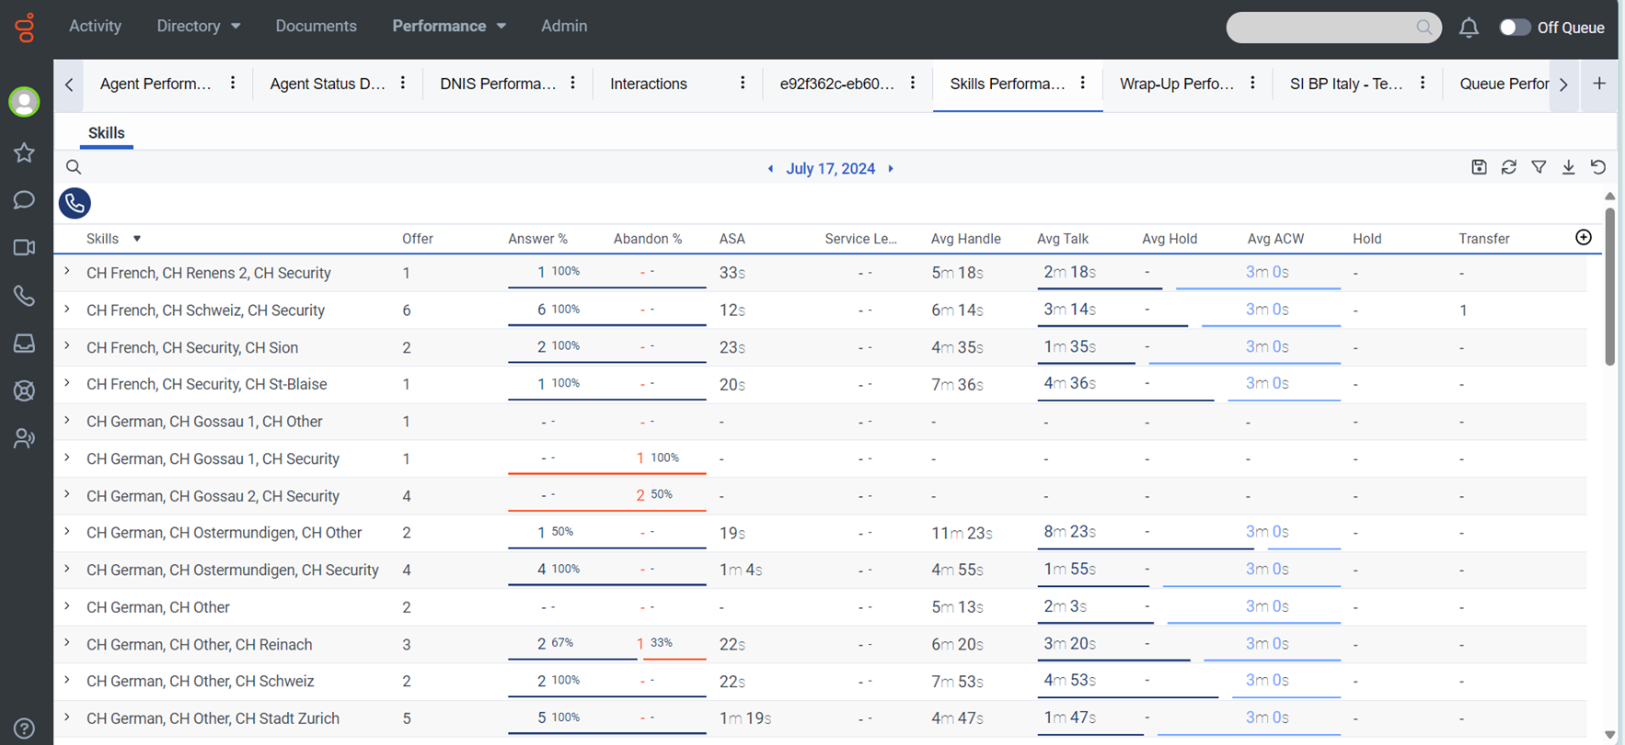
Skill performance report

Slide 13
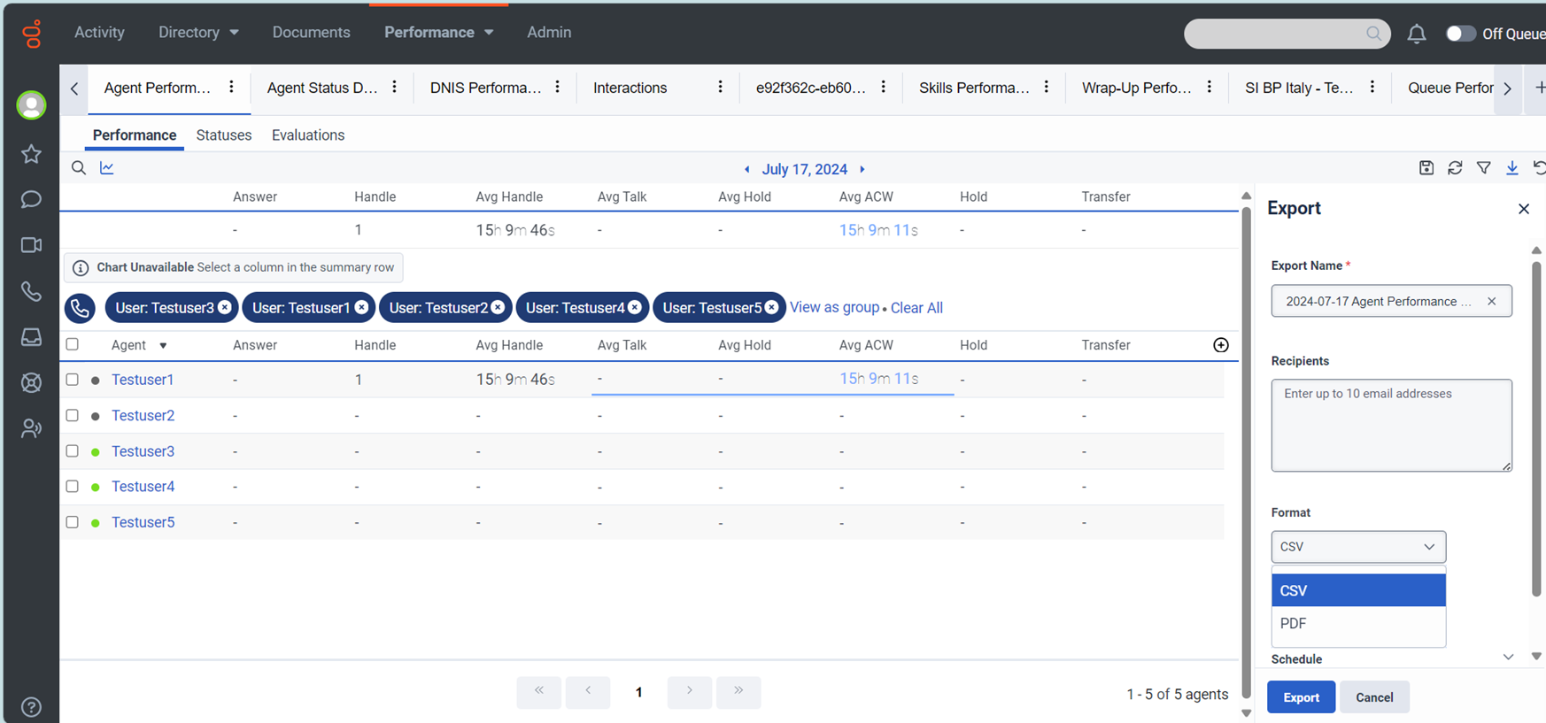
Download report

Slide 14
Schedule report

Slide 15
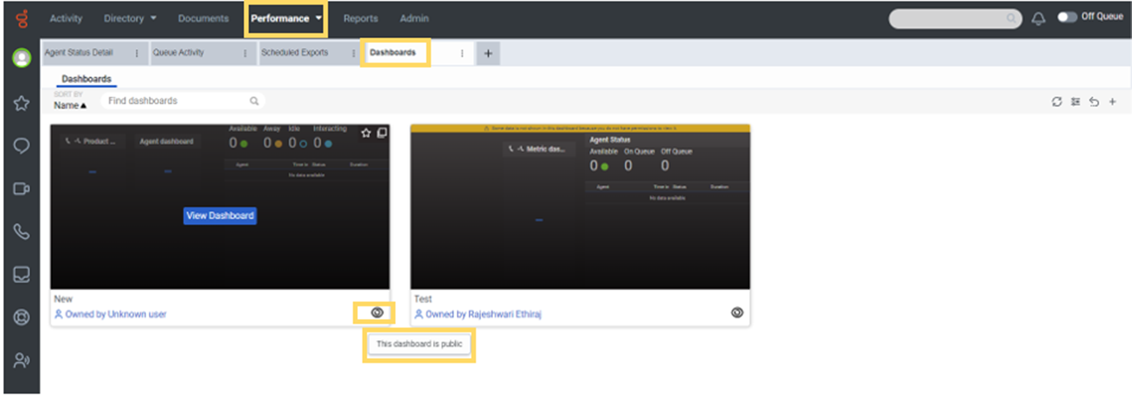
Publish dashboard

Slide 16
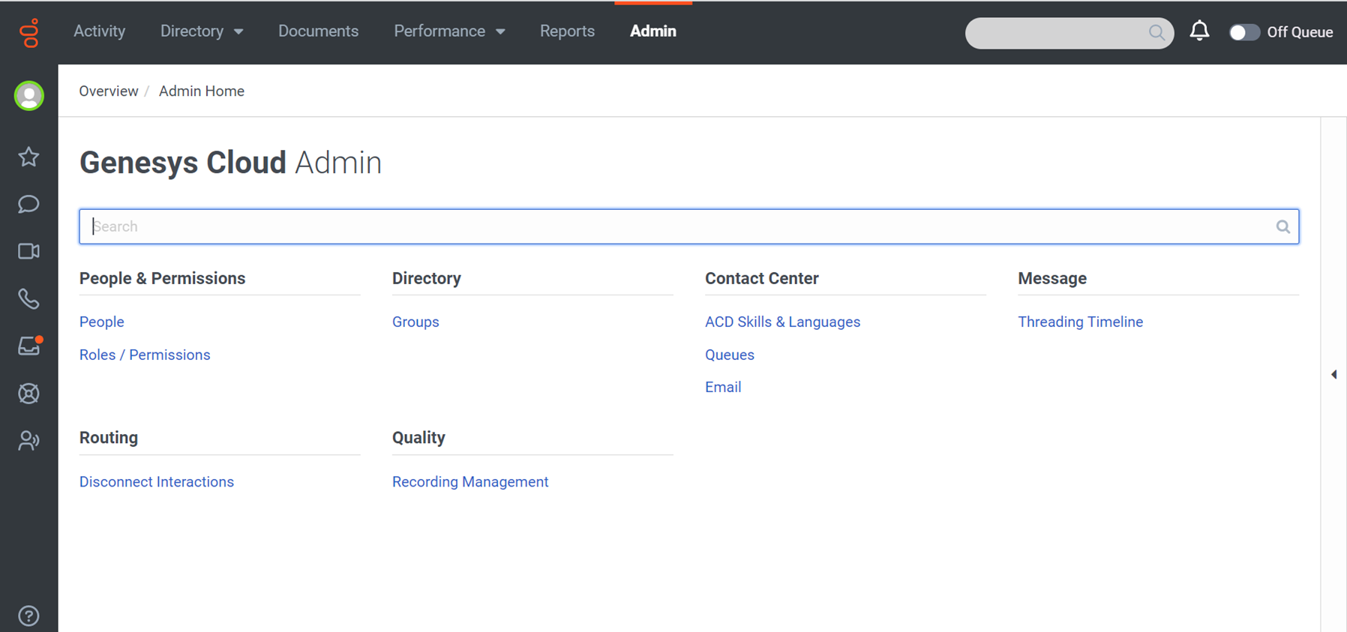
Admin

Slide 17
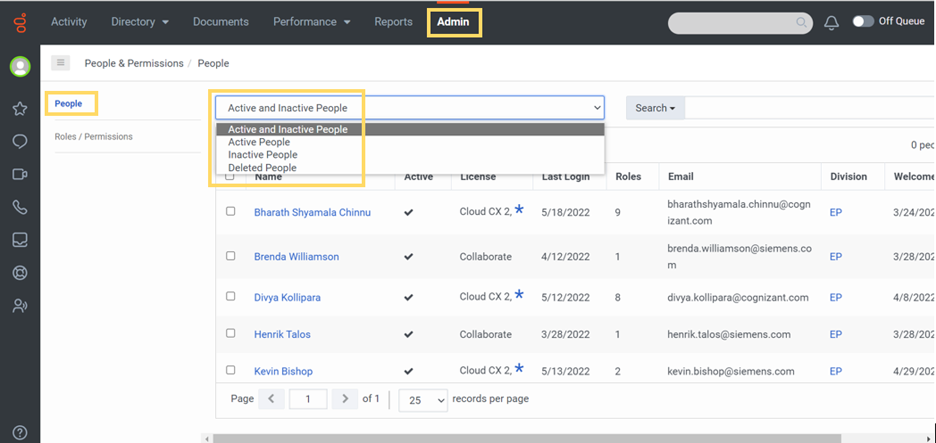
People management

Slide 18
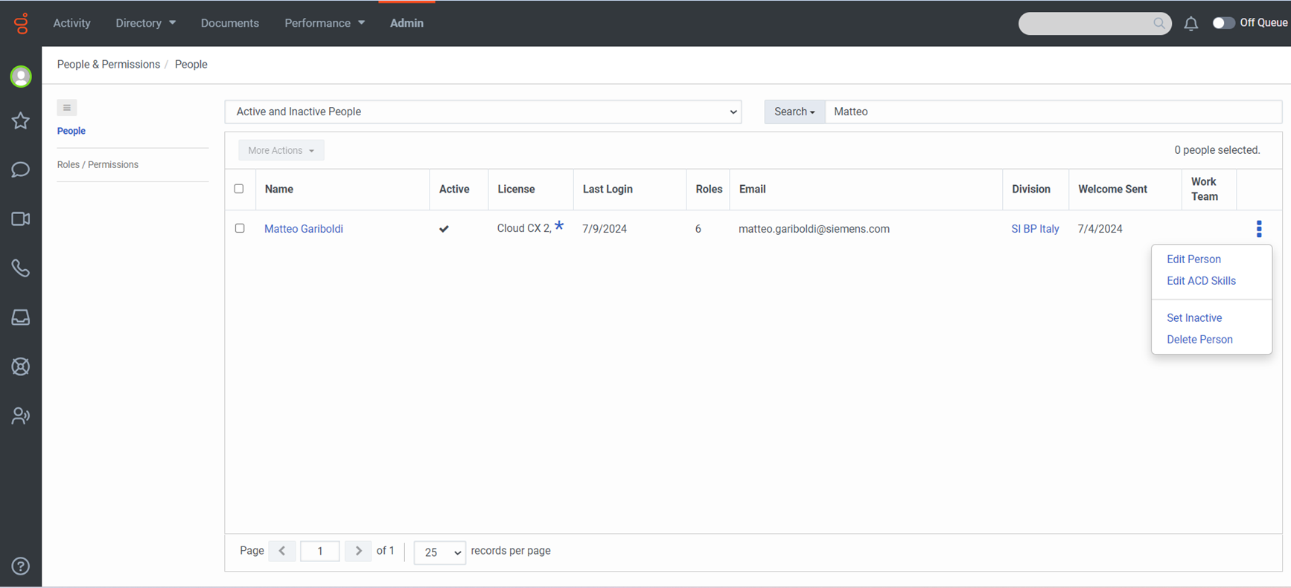
People - Edit user / ACD skills

Slide 19
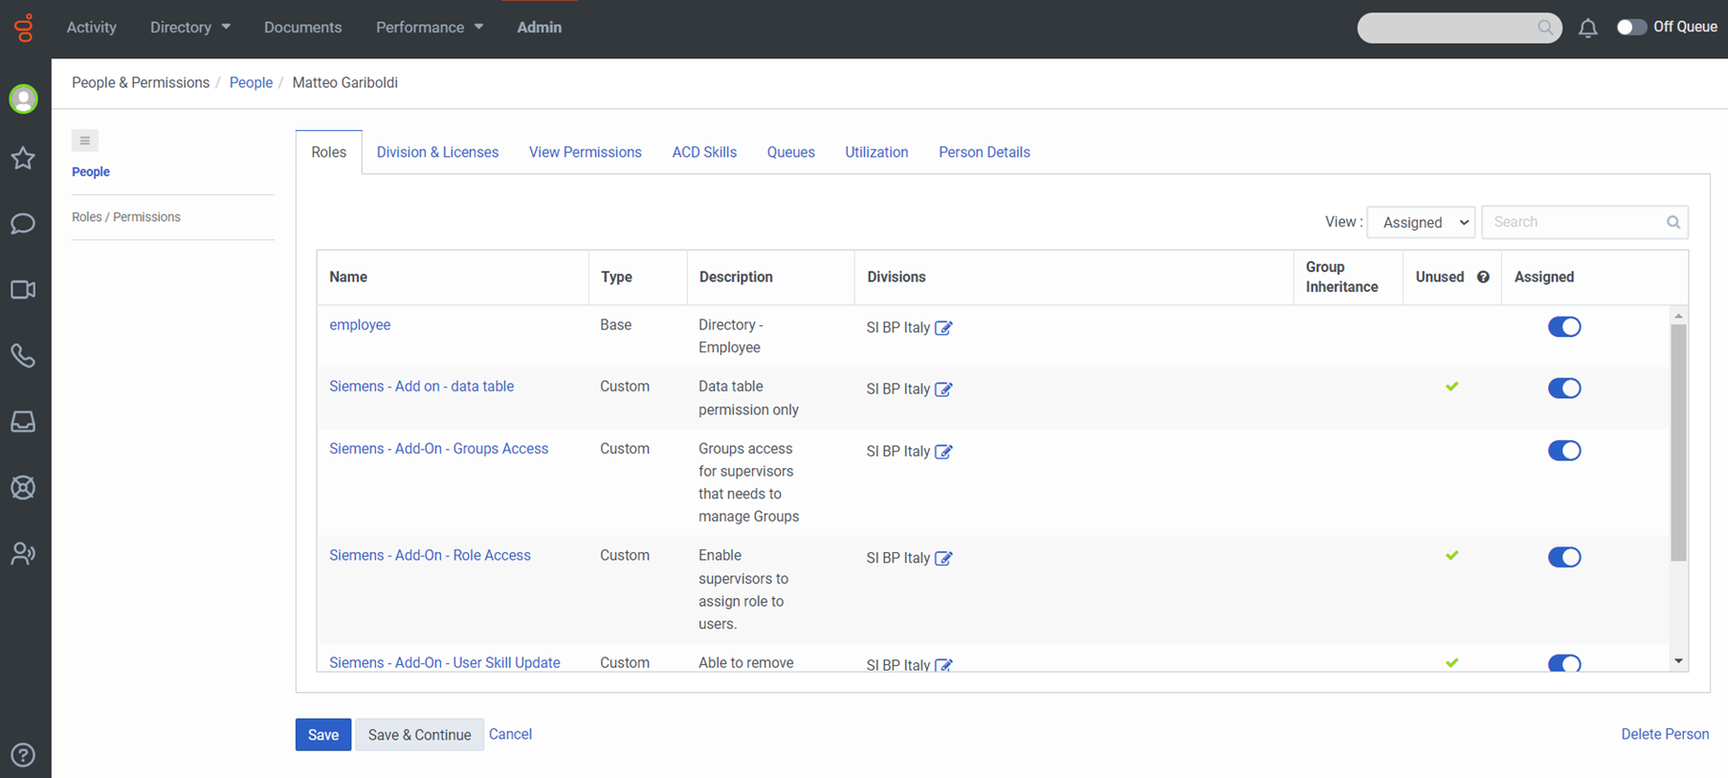
Roles

Slide 20
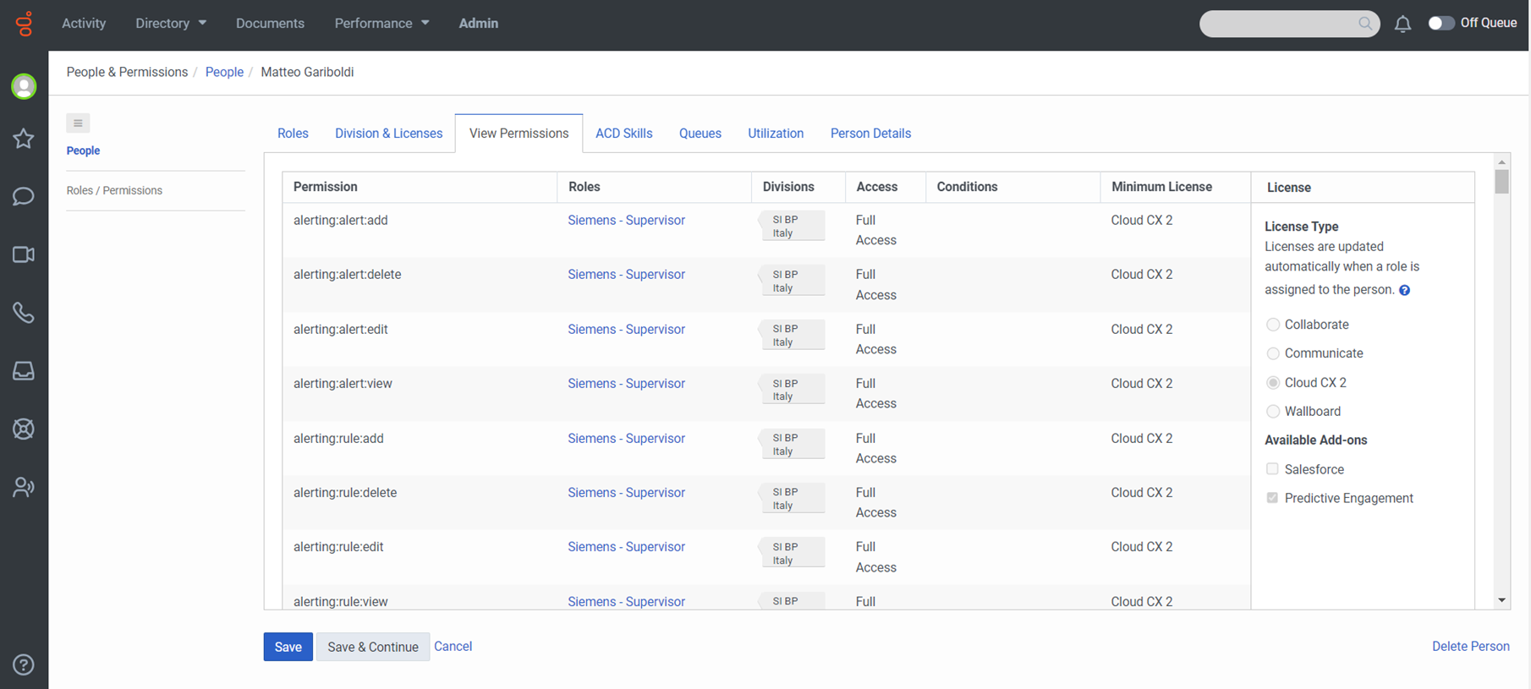
View Permissions

Slide 21
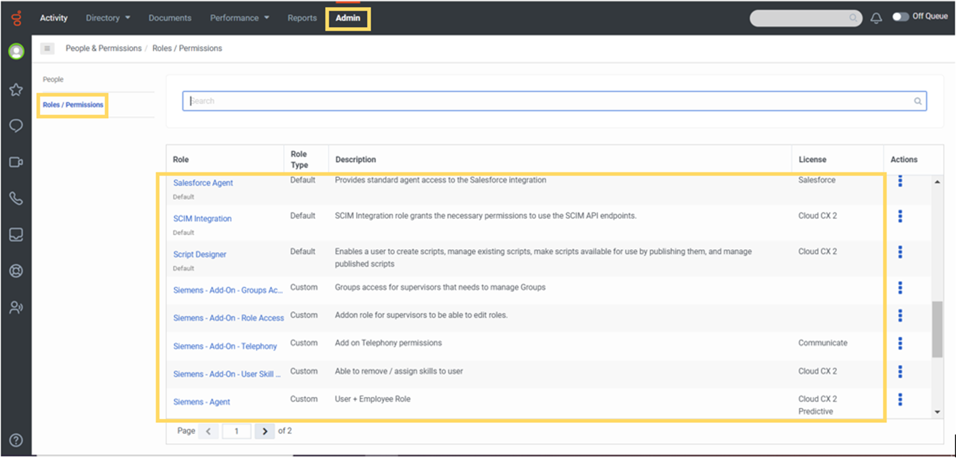
Roles/Permissions

Slide 22
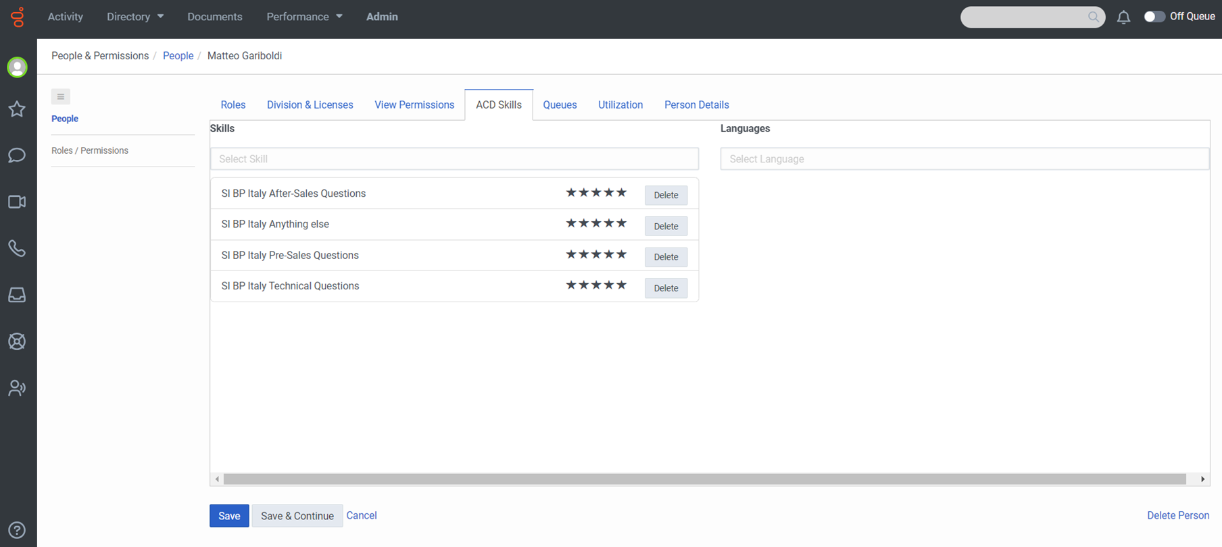
Assign Skills

Slide 23
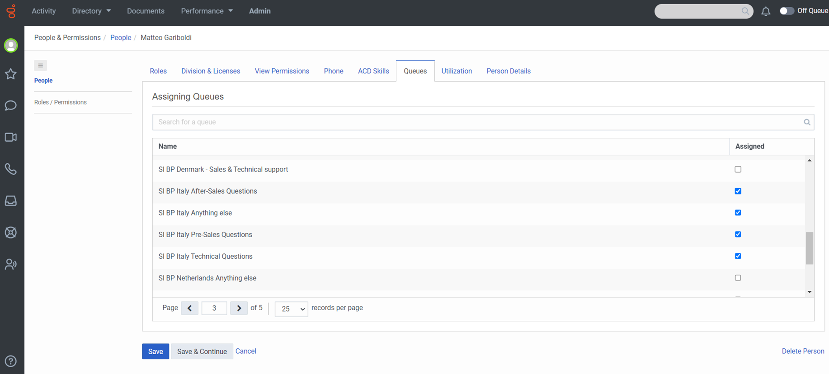
Assign Queues

Slide 24
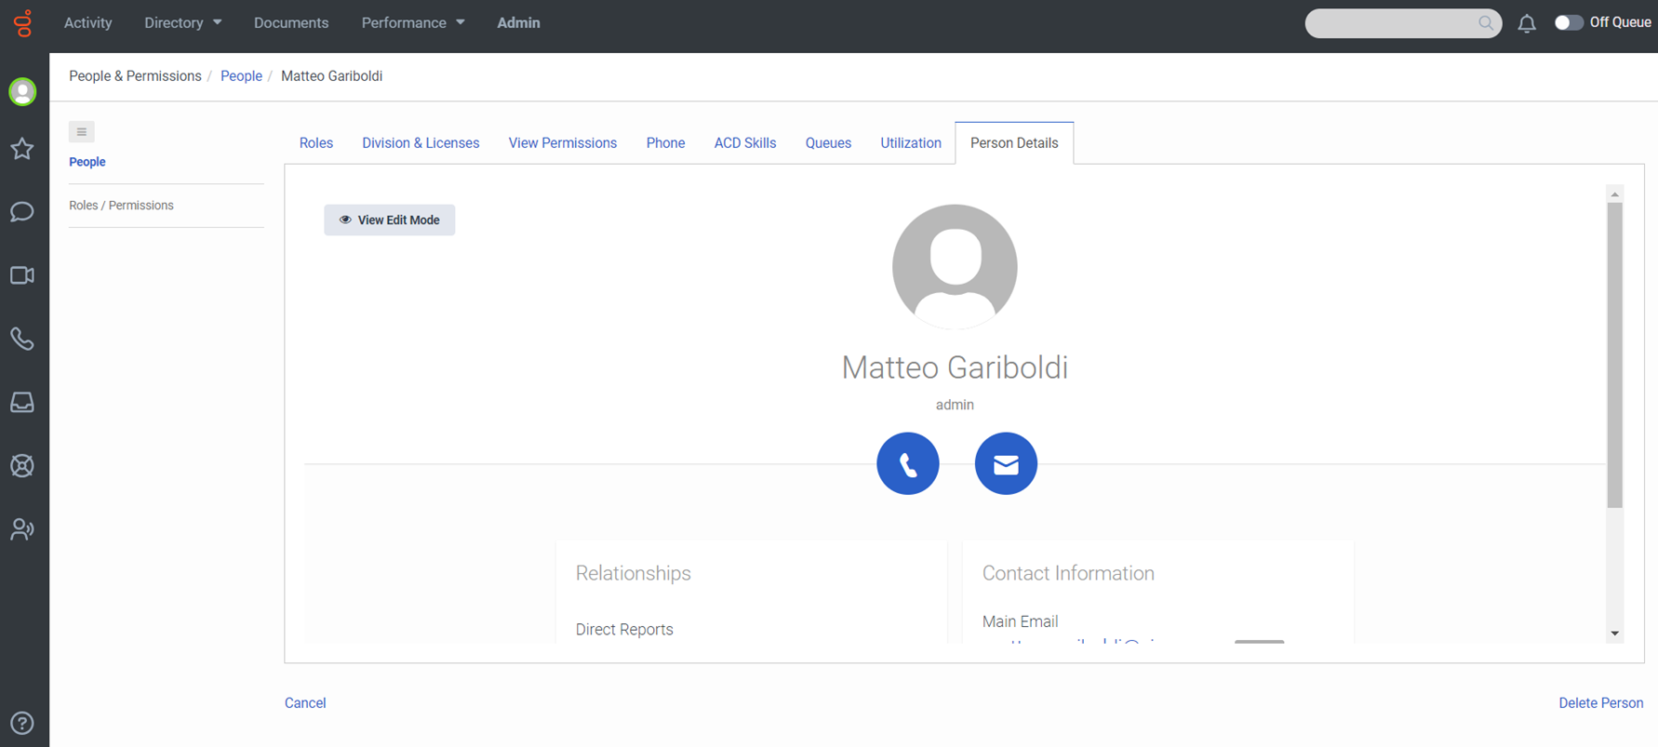
Person details

Slide 25
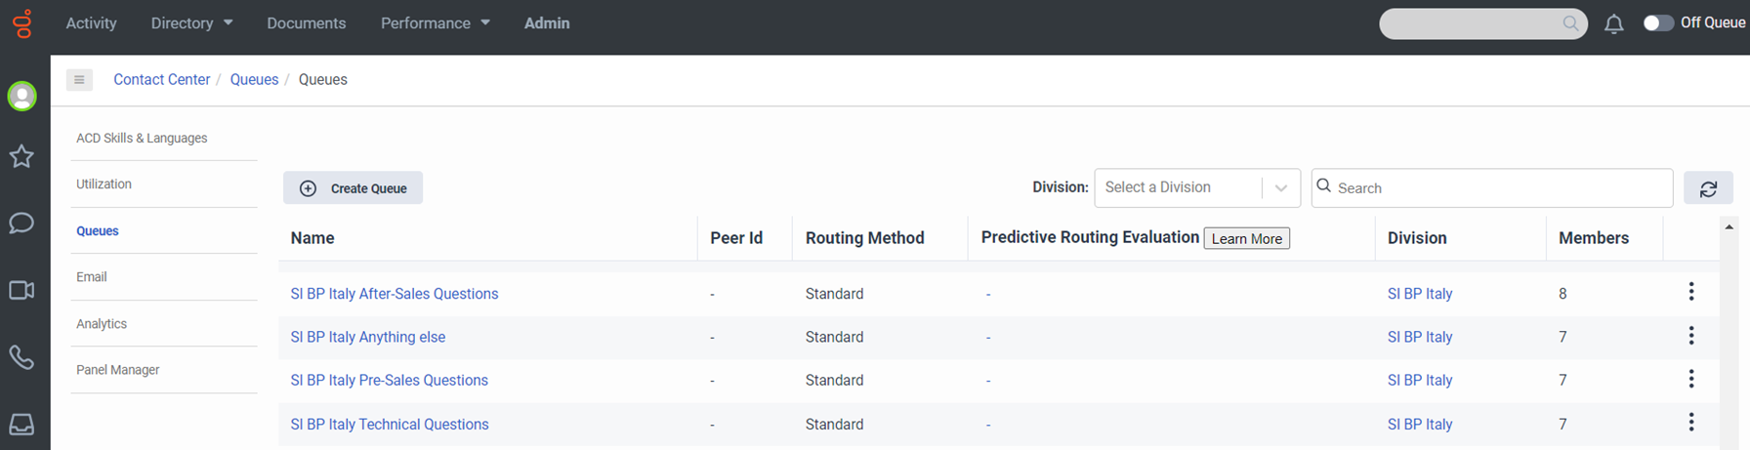
Queues

Slide 26
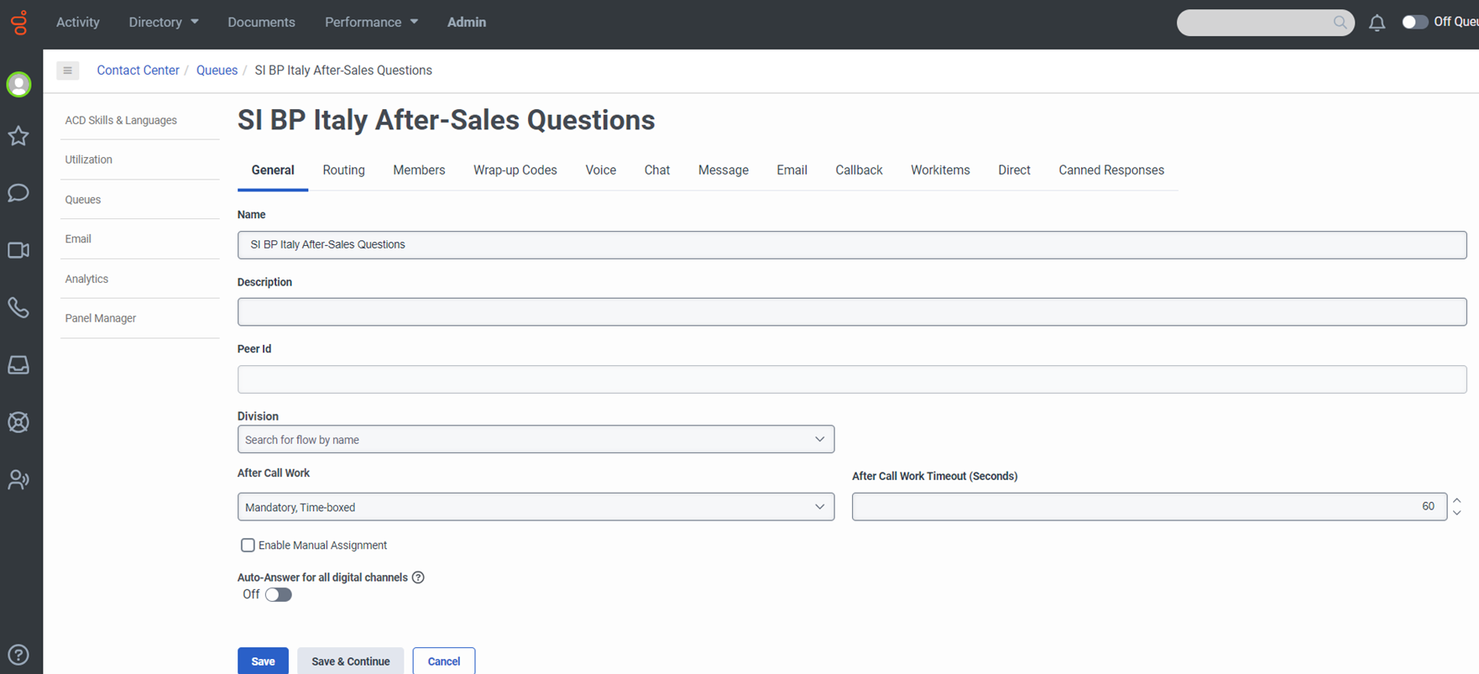
After Call Work settings at Queue level

Slide 27
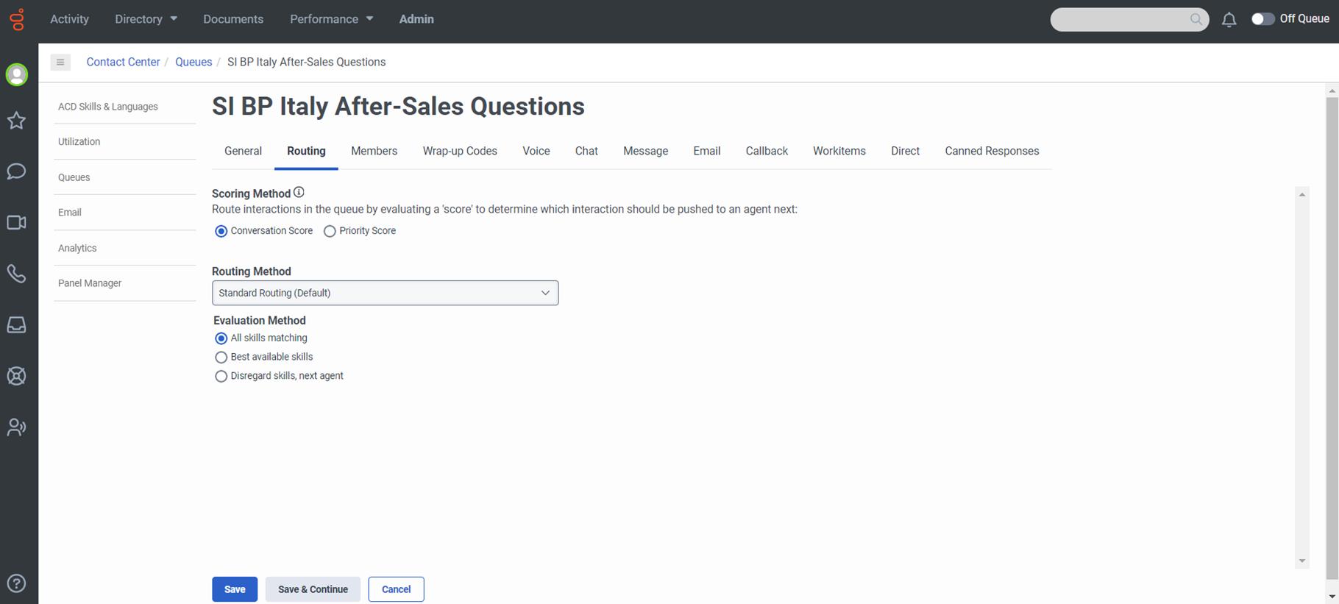
Routing Method

Slide 28
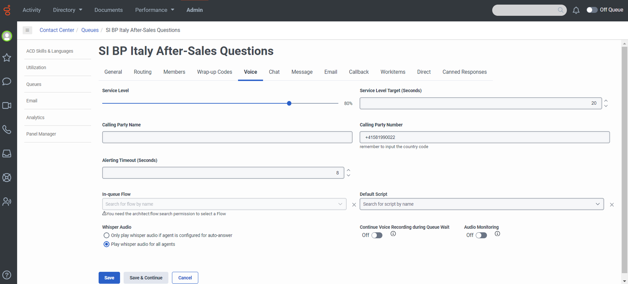
Service Level and Incoming Call Alerting Time

Slide 29
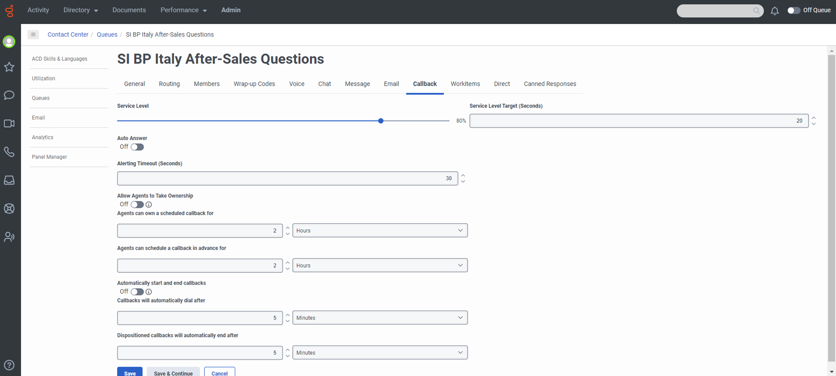
Callback settings

Slide 30
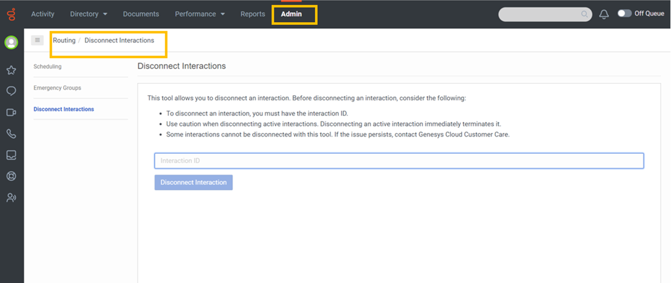
Disconnect Interactions

Slide 31
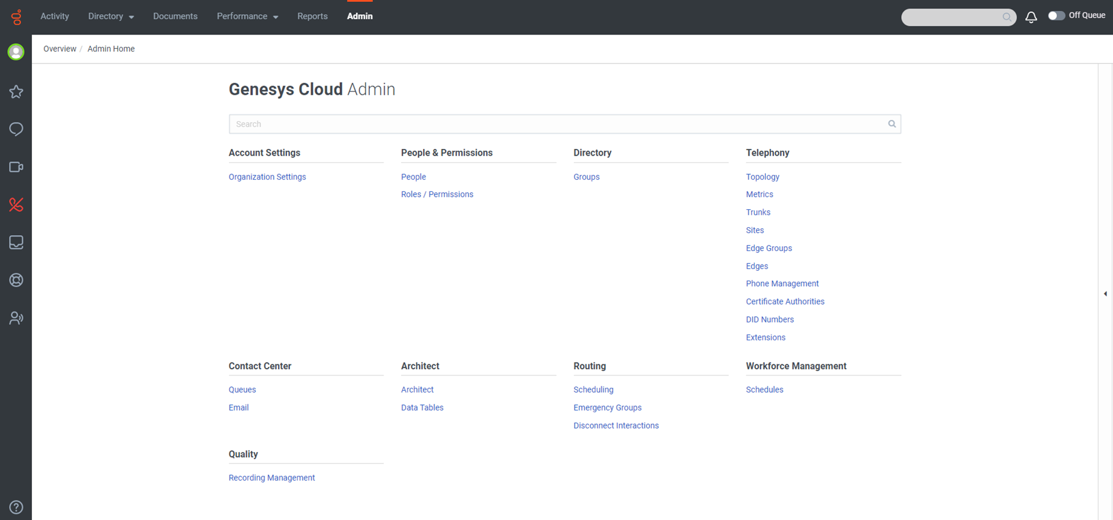
Admin

Slide 32
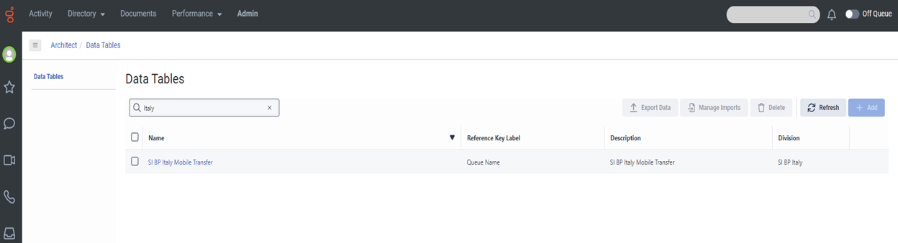
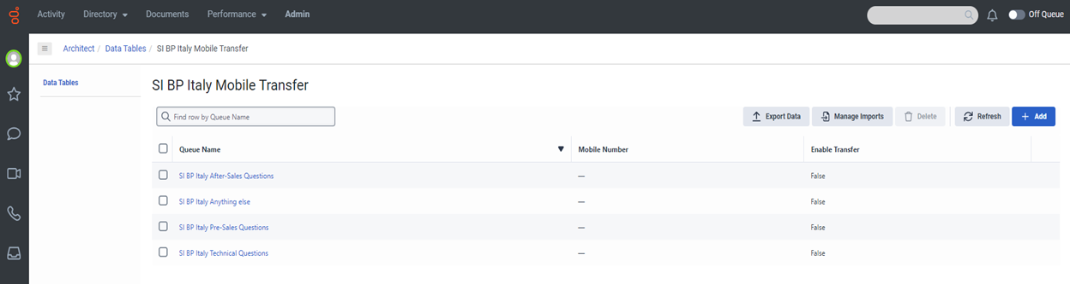
Data Tables: Forward to mobile number

Slide 33
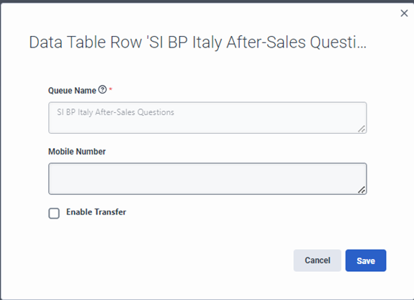

Slide 34
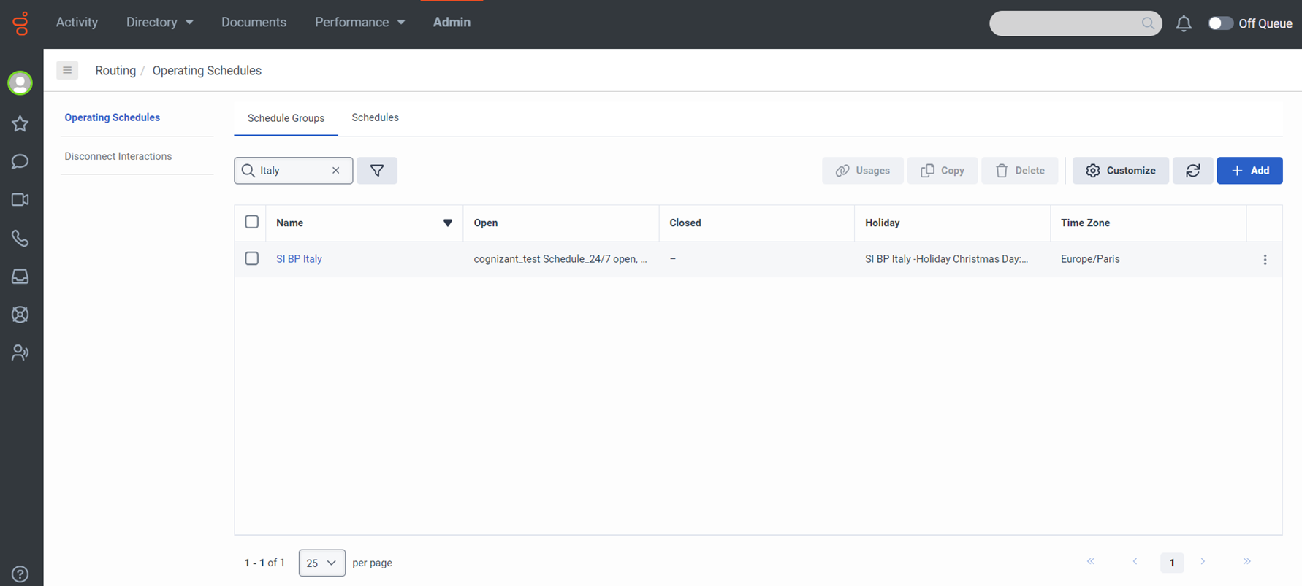
Scheduling – Schedule Groups

Slide 35
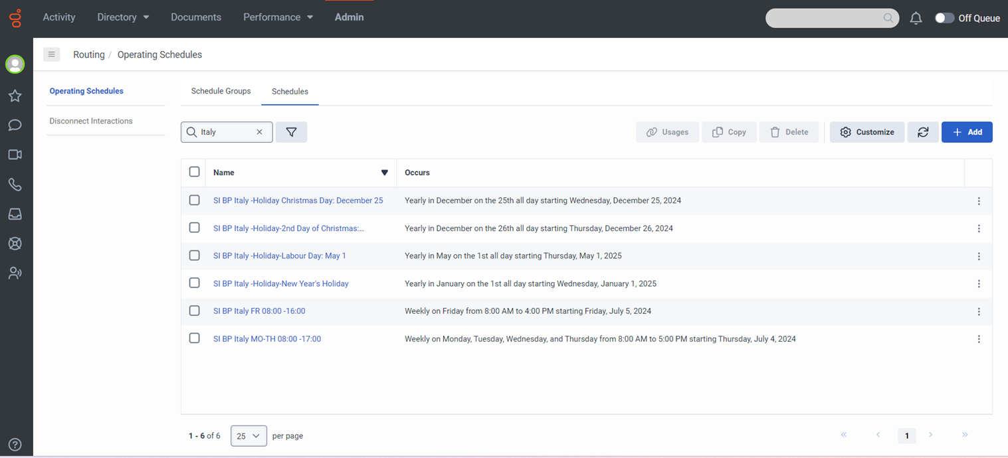
Scheduling - Schedules

Slide 36
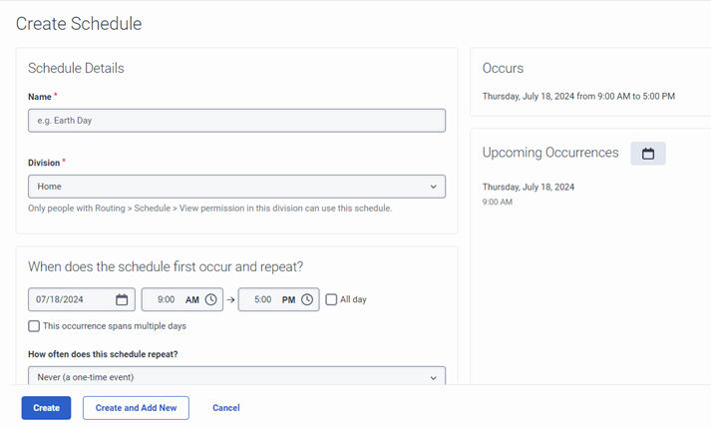

Slide 37
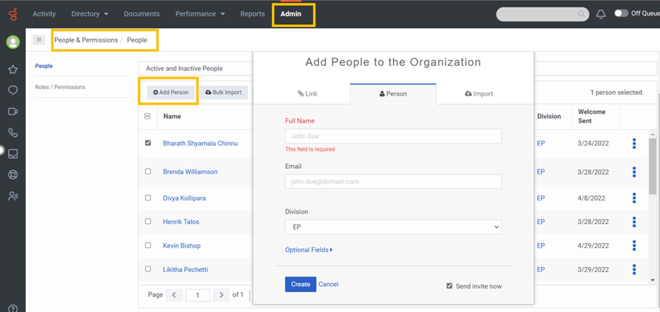
Add new user/assign roles

Slide 38
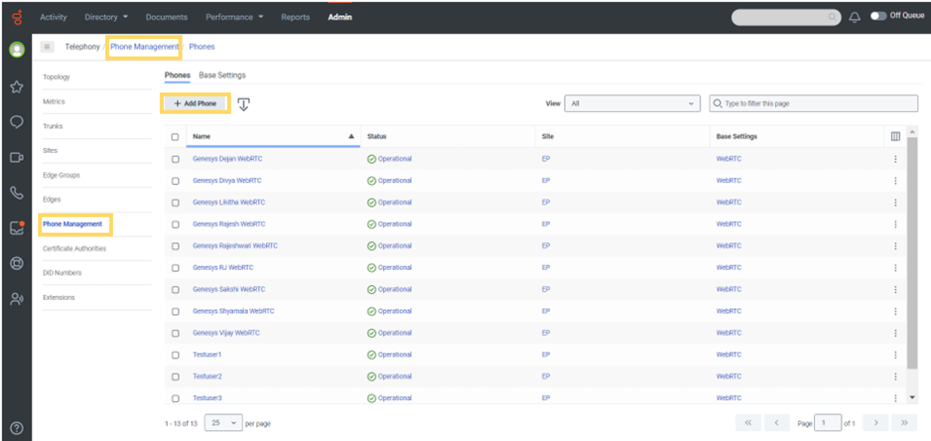
Phone Management

Slide 39
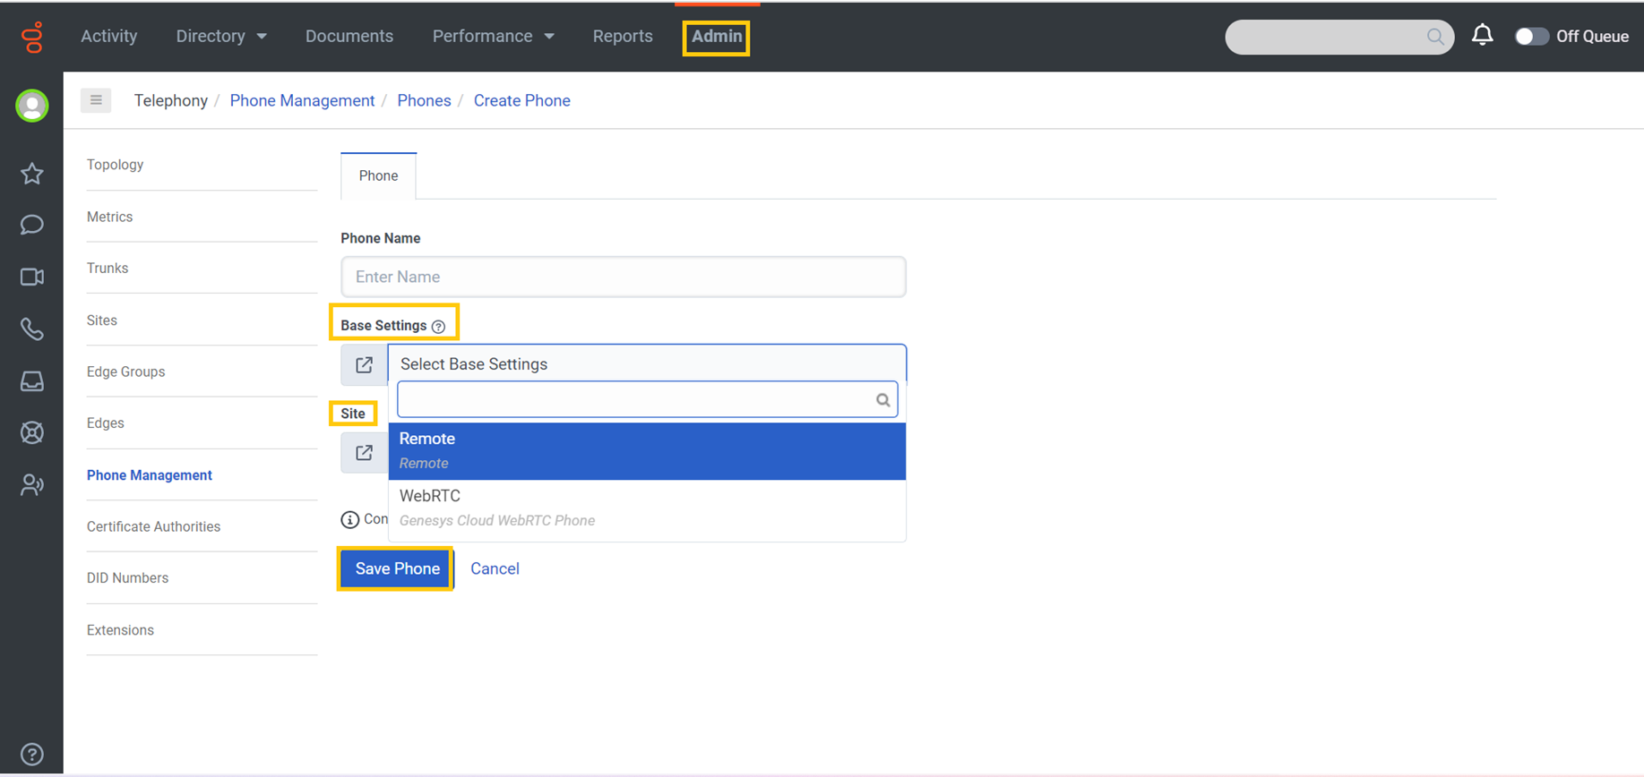
Add phone

Slide 40
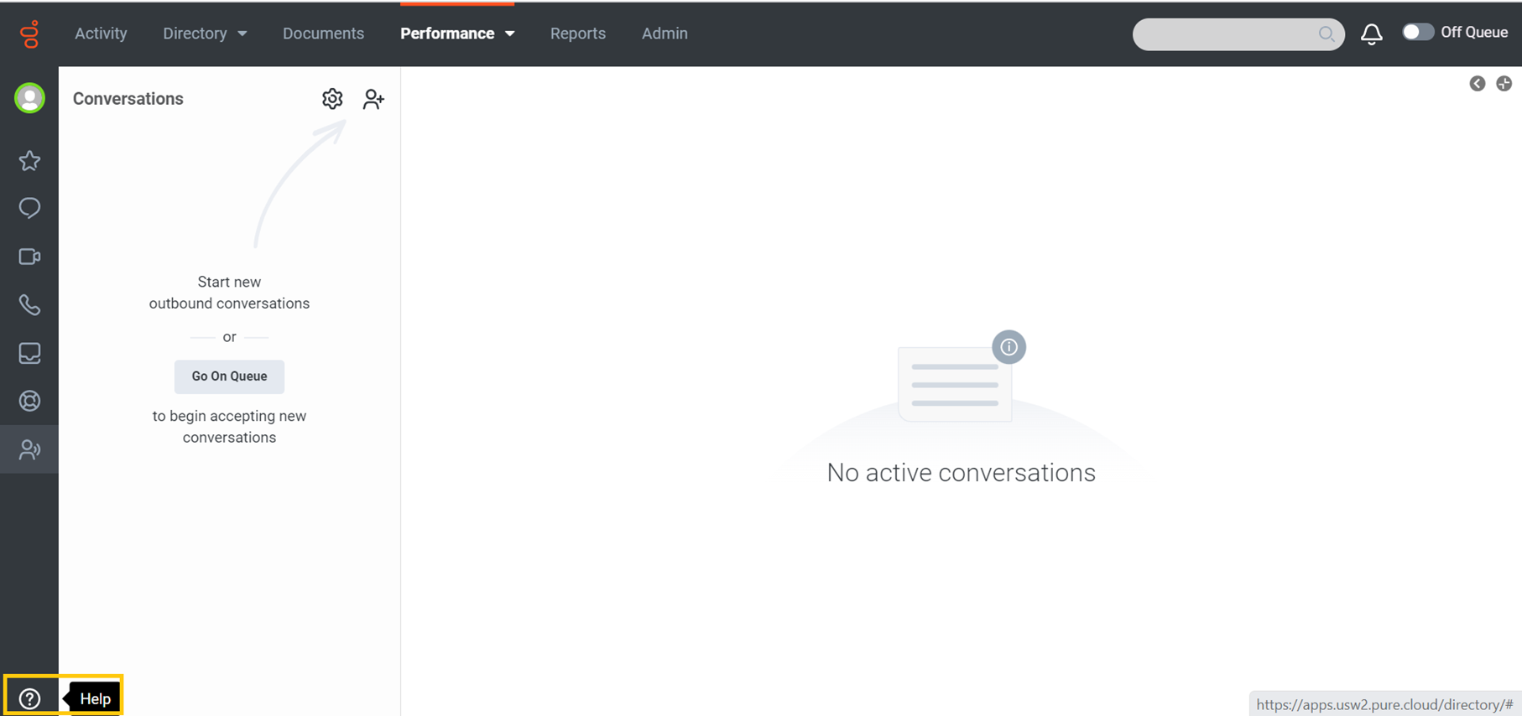
Help

Slide 41
